Slide 1



Project Module 3 classification
Bahnisikha DUTTA
Mathieu LAPEYRE
Palash Shastri
Group 9
ECE6780
Spring 2016, Professor May D. Wang

Slide 2
Objective
Ultimate Goal: Cancer Clinical Decision Support enabled by Medical Image Processing of Histopathological Images
Previous Goals (Modules 1,2)
Image Segmentation
Feature Extraction
Current Goals (Module 3)
Image classification
Prediction modelling

Slide 3
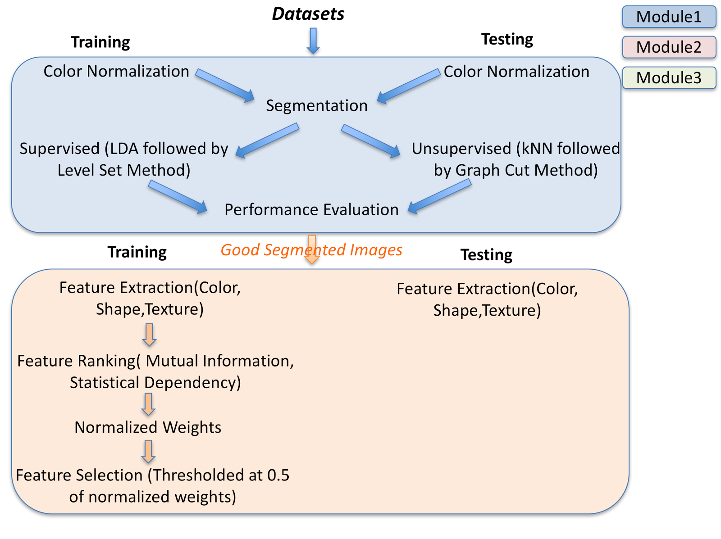
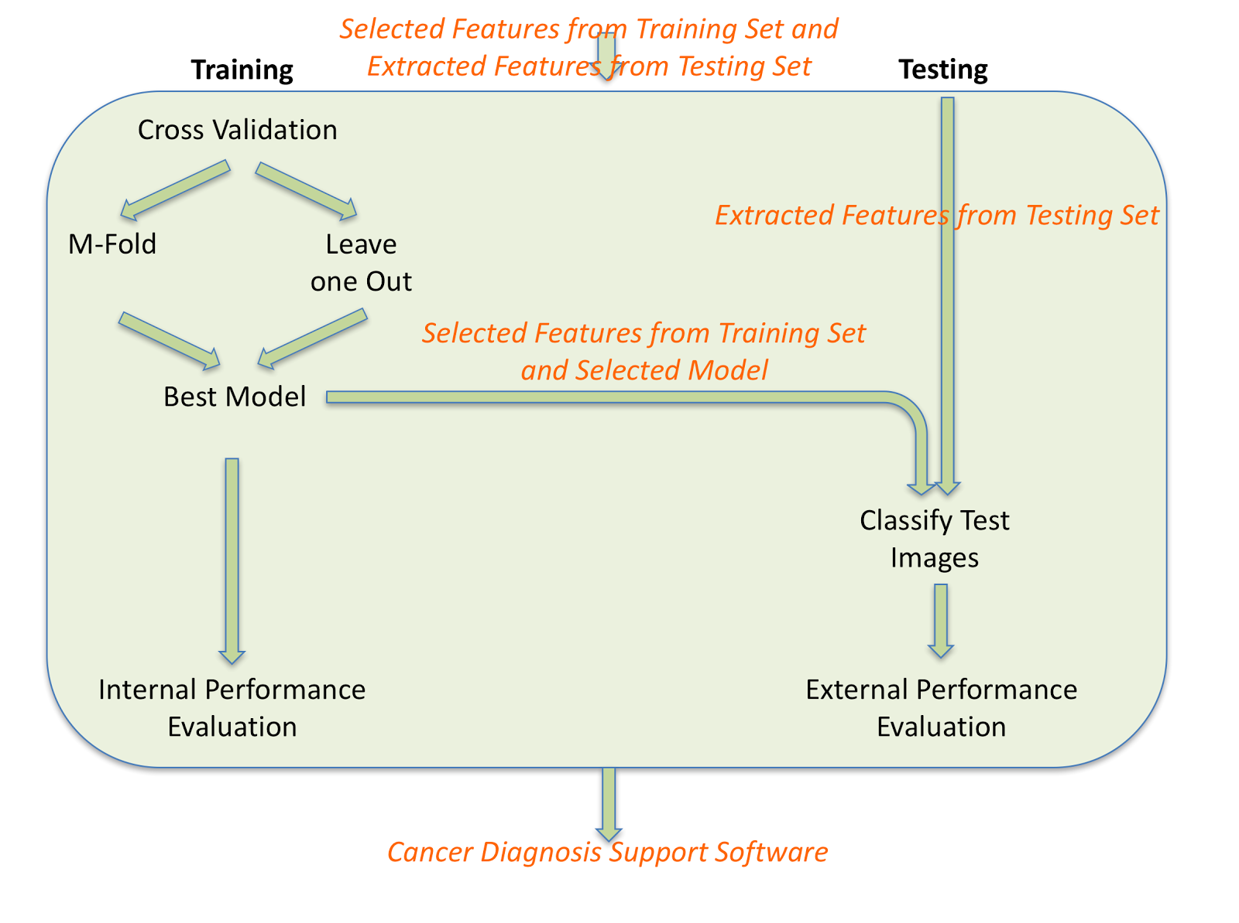
Workflow Diagram

Slide 4
literature critique
Strategies | Papers | Location/Time | Strength/Weakness | Selected
Reviews | Bellazi et al | Int J Med Inform, vol. 77, pp. 81-97, 2008. | Strength: 1) very elaborate 2) Discusses all problem/issues
Fisher Discriminant Analysis | Mika et al | Neural Networks for Signal Processing IX, 1999. Proceedings of the 1999 IEEE,Signal Processing Society Workshop., 1999, pp. 41-48. | Strength: 1) Very popular 2) Linear 3) Very fast and efficient Weakness: 1) Doesn’t work well for overlapping distributions. | No
Support Vector Machine | Cortes et al Chang et al | Machine Learning, 20, 273-297 (1995) National Taiwan University, Taipei, Taiwan, March 2013 (revised) | Strength: 1) very popular 2)both linear and non-linear data 3) Very fast and efficient Weakness: 1)single model cannot be used for multi-class classification problems, 2)computationally complex and expensive. | Yes
Neural Network | Jain et al | IEEE computer, vol. 29, pp. 31-44, 1996. | Strength: 1)effectively model high dimensional features Weakness: 1) Time consuming 2) Over fitting | Yes
Notes:
Split the table into 2 slides if reqd
Explain what exists, what is lacking, by who and when
+ one summary table to summarize literature critique to assess strength/weakness of methods
WHAT you researched and learned, and WHY you picked up these methods

Slide 5
literature critique
Strategies | Papers | Location/Time | Strength/Weakness | Selected
K-nearest Neighbor | Pereira et al | NeuroImage, Volume 45, Issue 1, Supplement 1, March 2009, Pages S199-S209 | Strength: 1)Simplest classifier. 2)No parameter learning encountered. 3)Very fast and efficient to implement. 4)Works very well for separable clusters Weakness: 1)Dependent on the choice of number of neighbors and data distribution. 2)Doesn’t work well for overlapping distributions. | Yes
Decision Tree | Safavian et al | IEEE TRANSACTIONS ON SYSTEMS, MAN, AND CYBERNETICS, VOL. 21, NO. 3, MAYIJUNE 1991 | Strength: 1)Have very low variance. Weakness:1)Random initialization so different result every-time. 2) Run-time complexity increases with the increase in number of trees and features. | Yes
Performance Metrics | Zhu, Xingquan Powers et al. | The business impact of predictive analysis, IGI Global, 2007 Evaluation: from precision, recall and f-score to ROC, informedness and correlation, Journal of Machine Learning, 2011 | Strength: Matthews coefficient is regarded as being the best coefficient to summarize the confusion matrix in one number. F-Score is a good metric to see balance between precision (exactness) and recall (completeness). Weakness: Classification Accuracy alone cannot be trusted to select a well performing model. This is the Accuracy paradox | A combination of: Accuracy Sensitivity Specificity Precision Recall F-Score Gmean Matthews Coefficient
Notes:
Split the table into 2 slides if reqd
Explain what exists, what is lacking, by who and when
+ one summary table to summarize literature critique to assess strength/weakness of methods
WHAT you researched and learned, and WHY you picked up these methods

Slide 6
Available features
STATISTICS
1628 computed features.
Top 100 selected with Statistical Dependency and Mutual Information.
Reduced with PCA and t-SNE
144 color based features
264 shape based
1320 texture based
Texture features
Autocorrelation
Contrast
Correlation
Cluster Prominence
Cluster Shade
Dissimilarity
Energy
Entropy
Homogeneity
Maximum probability
Sum (variance, average, …)
Difference (variance, entropy, …)
Information measure of correlation
Inverse difference moment
Shape Features
Area
Major Axis
Minor Axis
Eccentricity
Orientation
Convex Area
Solidity
Filled Area
Euler Number
Extent
Perimeter
Color Features
Red Channel
Green Channel
Blue Channel
L Channel
A Channel
B Channel
Hue Channel
Saturation Channel
Value Channel
Notes:
Conversion to YCbCr space
Removal of white pixels by thresholding at 222 in the luminance(Y) space
Color Histograms with 16 bins in 3 color spaces: RGB, LAB, HSV
Shape features form the basis of low-level object understanding
Shape features gives you geometric information that is unique to that object
Extracted for each stain separately
Easily computable textural features based on GLCM and Fractals
Applied to stained images
Computed with different displacement and orientation values.

Slide 7
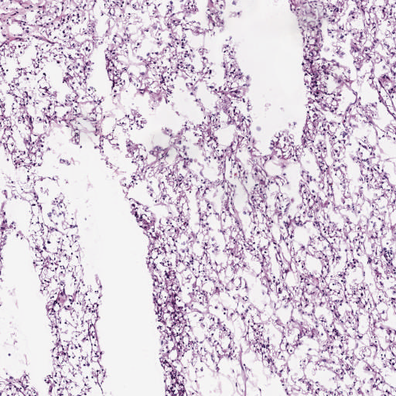
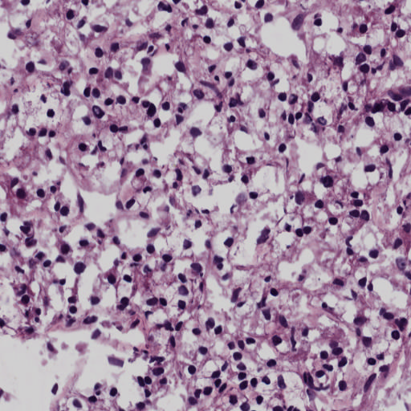
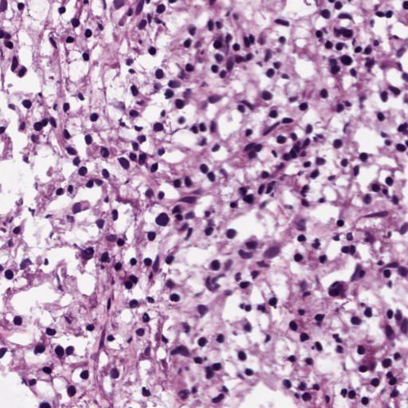
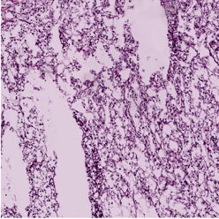
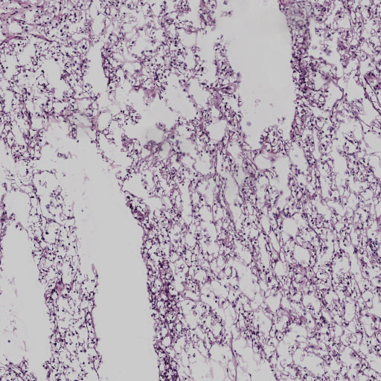
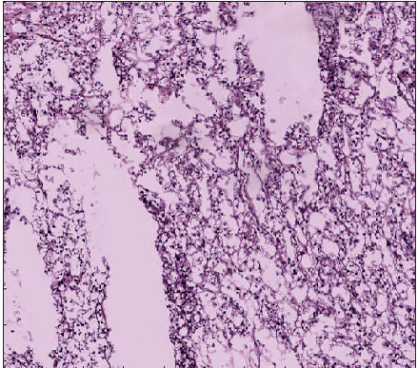
IMAGE Normalization
Batch (i1)
Colormap (i1)
Total unique colors (i1)/total no. of images in batch(n1)
Dataset 2/3
Mean, Std unique colors
Batch (i2)
Colormap (i2)
Total unique colors (i2) /total no. of images in batch(n2)
Batch (ik)
Source
Total unique colors (i3) /total no. of images in batch(nk)
Colormap (ik)
Both Source and Target normalized to a base color map
Total unique colors (iS)/No. of images
in the batch after outlier detection
Source image batch
Colormap iS
Within one std of mean
Not within one std of mean
Reinhard
Target
Map to mean color map
Map to mean+-std color map
Rather than using Reference image/batch for finding target colormap, we use the mean color map across a dataset
CDV-L

Slide 8
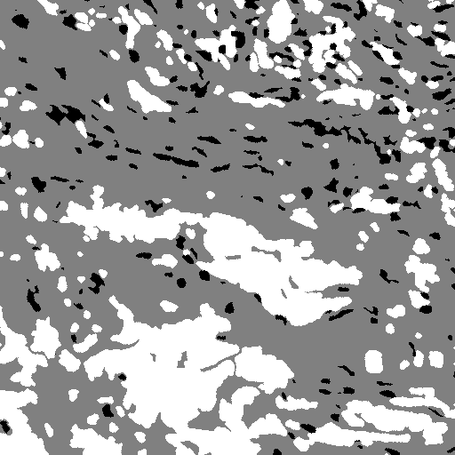
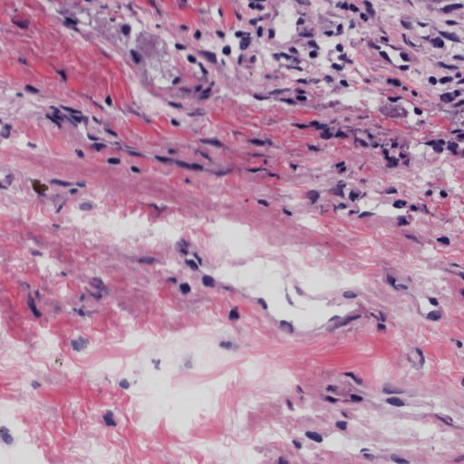
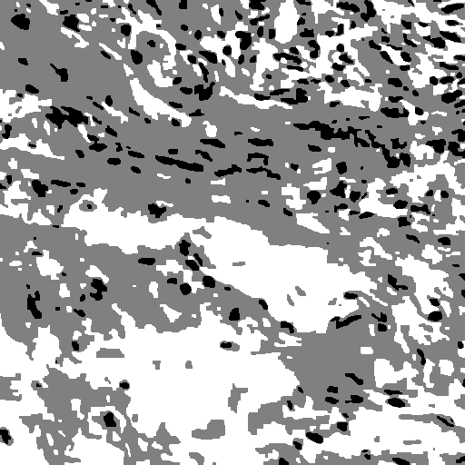
SEgmentation
Supervised:
Preparation of Ground Truth using Manual Segmentation: ~10% of each Dataset
Each Ground truth images were then splitted into the 9:1 ratio for preparation of training and testing set
LDA classifiers were trained on the training dataset and tested on others
The best performing classifier was used to segment the images
Level Set algorithm was used to smooth out the segmentation result.
Supervised image
Reference image
Unsupervised:
Unsupervised image
FCM based unsupervised segmentation
3 clusters denoting 3 regions to segment
Morphological smoothing carried out after segmentation to fill in the holes

Slide 9
CLASSIFIERS USED
KNN
K-Nearest Neighbors is one of the most commonly used machine learning algorithms. Simple and intuitive to understand, it employs the distance metric (euclidean distance standard) and voting based scheme where the given test sample is assigned the label represented by most of its neighbors. Takes the number of neighbors, an important hyperparameter, as input. KNN’s are mainly used after feature reduction in a lower dimensional manifold space for better classification results.
NEURAL NETWORKS
Neural networks are biologically inspired novel machine learning paradigm that enables a computer to learn from observational data. Neural networks essentially is a network of input, hidden and output neurons that tries to learn an approximate representation of the given distribution of data. Neural networks are very good for learning high dimensional feature representation and have been the building blocks of the recently upcoming fields of deep learning.
SUPPORT VECTOR MACHINES
Support Vector Machines are kernel based machine learning algorithms that essentially leverage the fact that non-linear data in low-dimensional space can be separated using linear classifers when the features are projected into higher-dimensional space. Primary objective function is to find the optimal hyperplane that maximizes class separability and lowers misclassification error. It’s performance on a dataset is governed by the choice of kernel.
RANDOM FORESTS
Decision trees also known as random forests are an ensemble based learning mechanism where-in a group of weak classifiers are combined to form a strong classifier, leading to reduction in variances. Random forests work on the fundamentals of bagging and random selection of features. Multiple decision trees, learnt on the basis of information gain, are trained on randomly sampled features in an attempt to approximate the underlying data distribution. They are very efficient to train and compute.

Slide 10
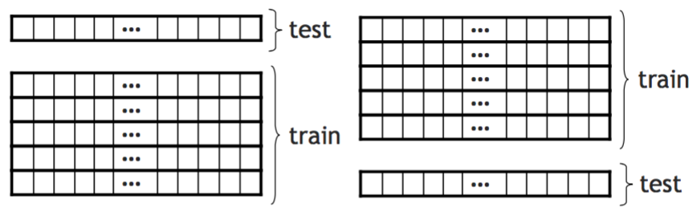
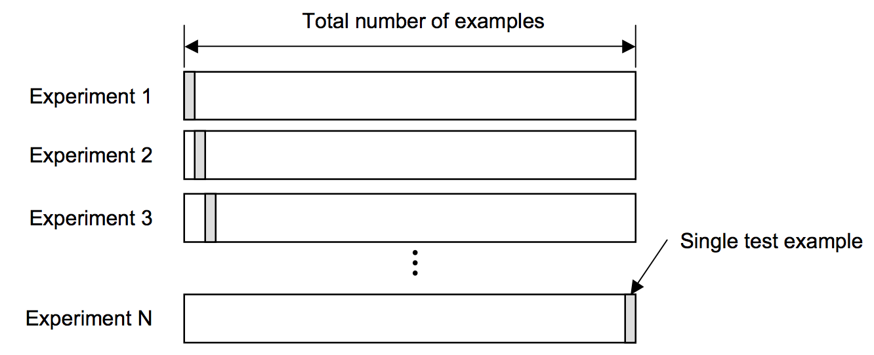
Cross validation
K-FOLD CROSS VALIDATION APPROACH
Cross validation is one of the key important factors in determining the generalizability of a model by tuning the parameters of the classifier on various partitions of training and test-data, specifically declared through the ‘k’ variable. Below figures illustrates the underlying concept.
1st fold
k-th fold
Leave one out
LEAVE ONE-OUT CROSS VALIDATION APPROACH
Leave one out cross validation approach is another method of implementing cross-validation where-in each sample is taken as a test sample and the remaining sample act as the training set. Essentially it is a special case of cross validation where you have same number of models as samples. Computational complexity increases immensely with the increase in number of training points.

Slide 11
Performance metrics
RATIONALE
Accuracy: Simple and easy to understand
Confusion matrix: Compute accuracy with distinction between classes
ROC: Show how many true positive can be gained as you allow for more and more false positives
AUC: One way to summarize ROC, as it is difficult to compare two curves in detail
Precision: How useful the classifier is
Sensitivity/Recall: How a classifier is good at detecting positives (How complete the classifier is)
Specificity: How a classifier is good at avoiding negatives
F-score: The harmonic mean of precision and recall
FORMULA

Slide 12
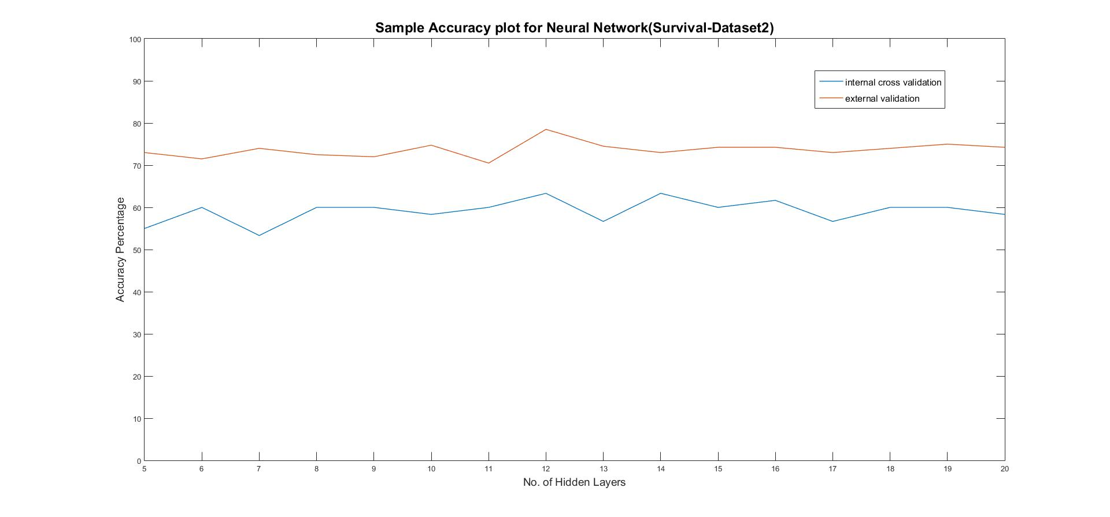
ANALYSIS
Accuracy vs Number of Hidden layers for Neural Network
Confusion matrices for grade classification for different datasets
Dataset 1
Dataset 2
Dataset 3
L | 1 | 2 | 3
1 | 22 | 0 | 0
2 | 1 | 26 | 0
3 | 0 | 0 | 37
L | -1 | 1
-1 | 12 | 8
1 | 3 | 17
L | -1 | 1
-1 | 14 | 1
1 | 5 | 4

Slide 13
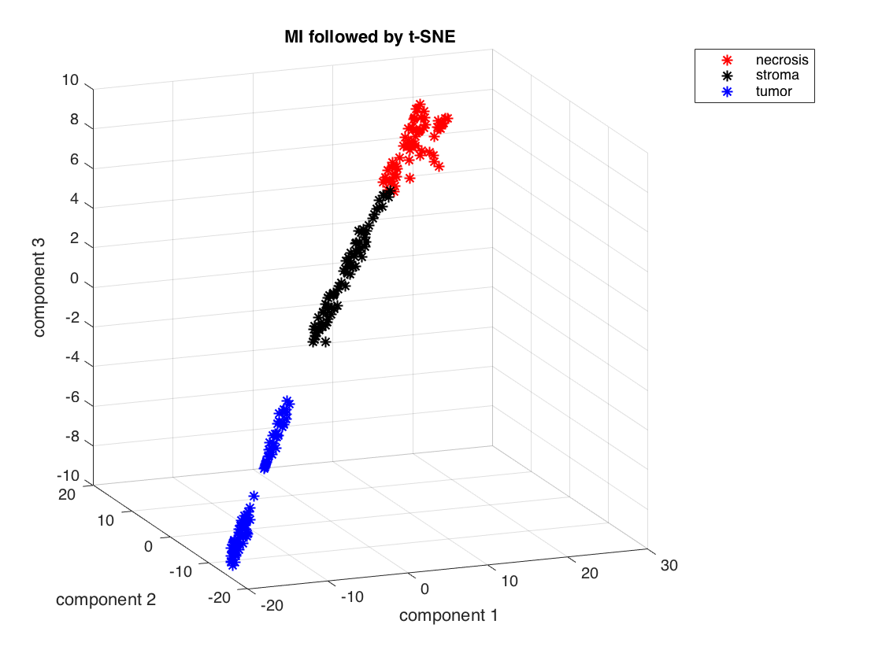
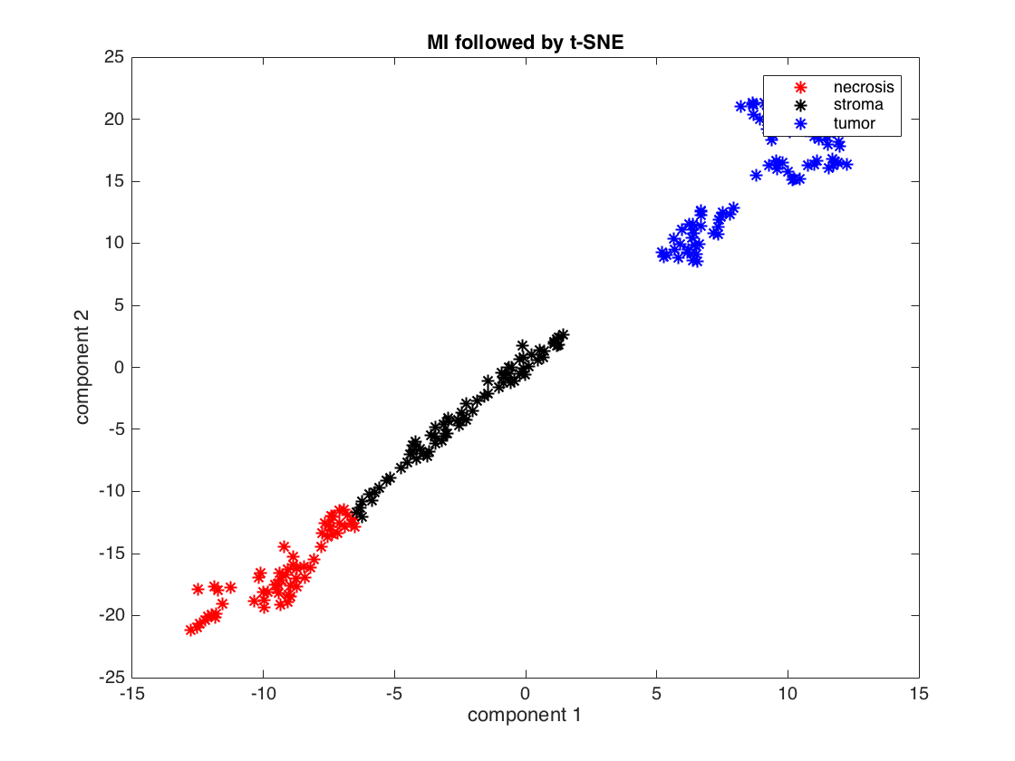
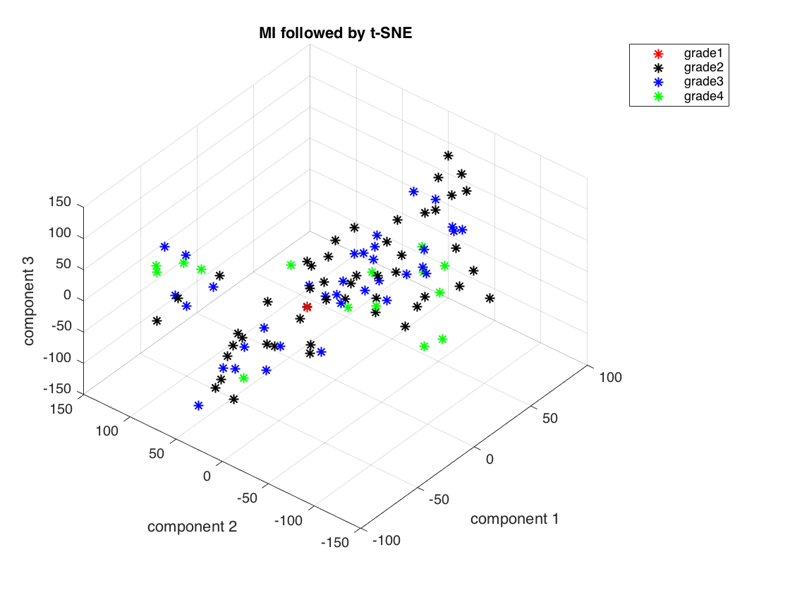
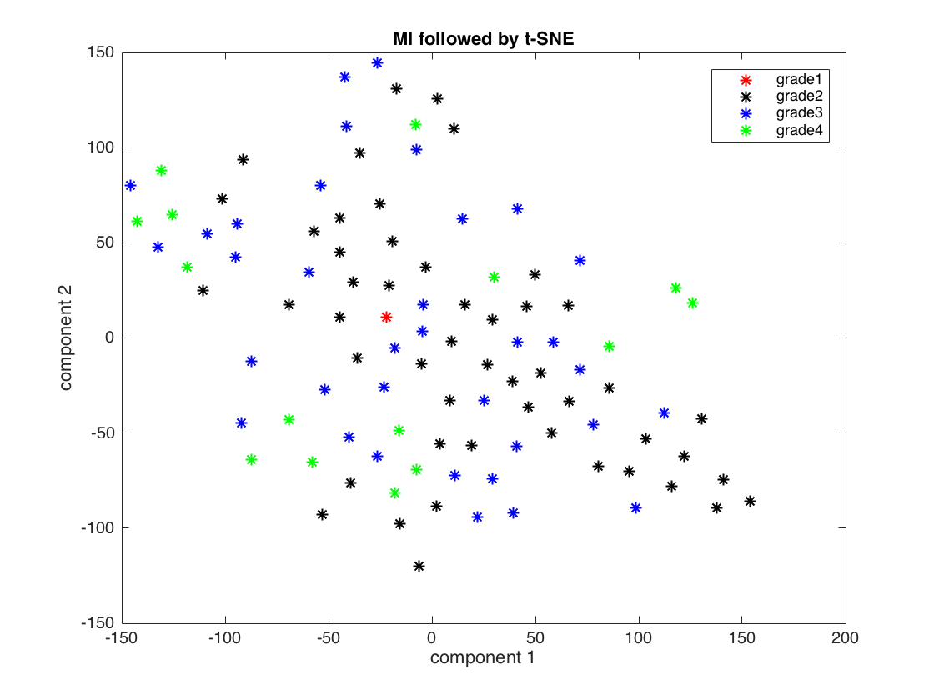
Reduced Feature PLots
Dataset1
Dataset2

Slide 14
Performance
Percentage Accuracy for Different Classifiers (Best Model Fit after Cross Validation, Grade)
Classifier | Dataset1 | Dataset2 | Dataset3
kNN | 98.8% | 50% | 37.5%
Random Forest | 100% | 57.5% | 52%
Neural Network | 100% | 67.5% | 60%
SVM | - | 72.5% | 70.83%
Various Metrics for Different Classifiers (Dataset2, survival)
Classifier | MCC | F-score | Recall | Accuracy | Sensitivity | Specificity
Random Forest | 0.6508 | 0.8205 | 0.8 | 0.825 | 0.8 | 0.85
SVM | -0.1549 | 0.4888 | 0.55 | 0.425 | 0.55 | 0.3

Slide 15

EXTRAS
SLIDES

Slide 16
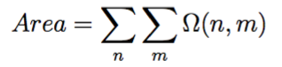
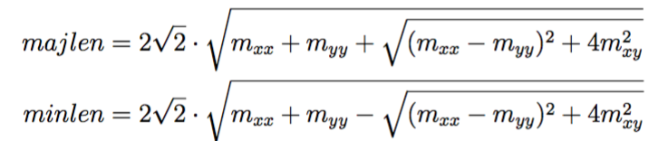
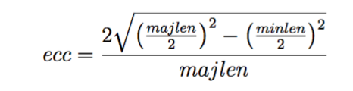
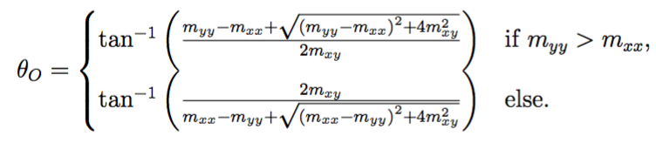
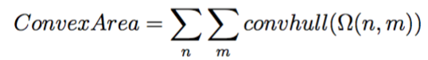
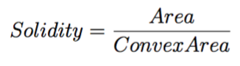
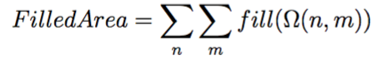
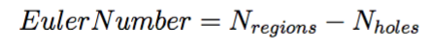
Features extraction
Shape-based extraction
Where omega(n,m) is the object mask, mxx and myy indicate second moments of x and y
Mathematical formulation of shape features-
Area -
Major Axis -
Minor Axis -
Eccentricity -
Orientation -
Convex area -
Solidity -
Filled Area -
Euler Number –

Slide 17
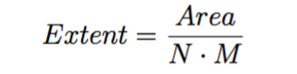
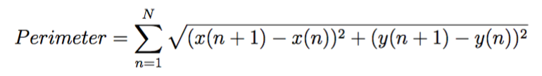
Features extraction
Shape-based extraction
Mathematical formulation of shape features-
10. Extent -
11. Perimeter -
Link

Slide 18
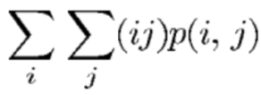
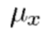
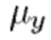
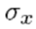
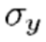
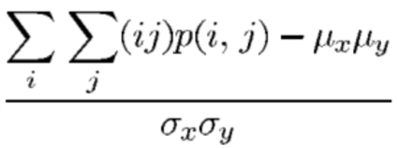
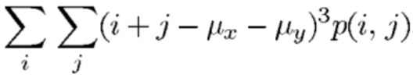
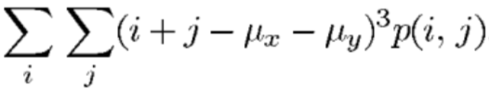
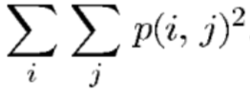
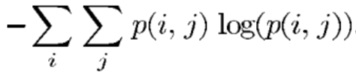
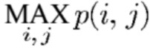
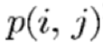
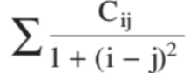
TEXTURE-BASED extraction
Autocorrelation
Contrast
Correlation
Cluster Prominence
Cluster Shade
Dissimilarity
Energy (angular second moment)
Entropy
Homogeneity
Maximum Probability
Variance
Information measure of correlation
Inverse difference
Inverse difference moment
Where , , and are respectively the mean and the standard deviation of the rows and columns of the matrix p(i,j), which is the (i,j)th entry of the GLCM.

Slide 19
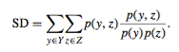
Features selection
Statistical Dependency(SD)
Measures dependency between features and the associated class labels
Larger the SD, more the dependency
Thresholding on the ranked features based on the SD weights
Followed by PCA

Slide 20
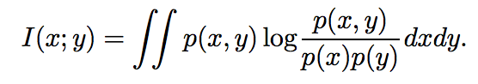
Features selection
Mutual Information/MI
Measures how much information the presence/absence of a term contributes to making the correct classification decision
Features ranked in descending order based on their mutuality
Above formulation shows an example for two random variables
Followed by PCA and t-SNE
Link

Slide 21
Dimensionality reduction
Two methods :
Principle Component Analysis (PCA)
Linear algorithm
Parameter free
t-Distributed Stochastic Neighbor Embedding
Non-linear machine learning algorithm
Relies on parameters (perplexity, early exaggeration, learning rate, number of iterations)
Particularly well-suited for high-dimensional dataset
Notes:
t-Distributed Stochastic Neighbor Embedding

